Slide 1

Configuring WEP on a wireless router
Done By:-
MTV Soumith
D. Chaitanya
C.Koushik Reddy
TSS Subramanyam

Slide 2
PROJECT ABSTRACT
WEP stands for Wired Equivalent Privacy, a Wi-Fi wireless network security standard.
The goal of WEP is to make wireless networks as secure as wired networks, such as those connected to ethernet cables.
Our Objective is to Configure WEP security between a client computer and wireless router

Slide 3
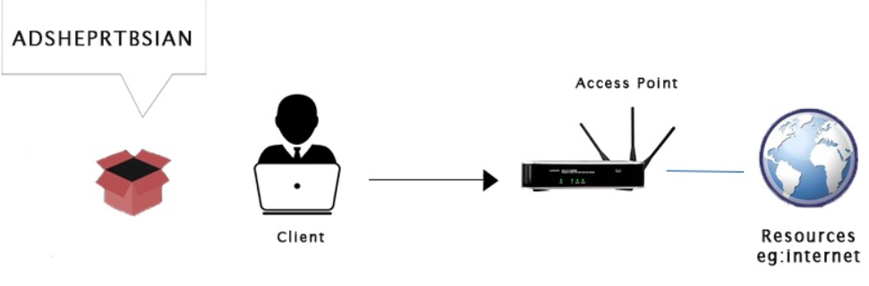
Intoduction
WEP (Wired Equivalent Privacy) it is the oldest one and can be easily broken.
WEP uses RC4 encryption.
In this algorithm each packet is encrypted at the router or access point .
If the client sends something to the router. It will first encrypt the packet using a key, send it to the router, and the router will be able to decrypt it, because it has the key.
In this process, if a hacker captures the packet in the middle, then they will get the packet, but they wouldn't be able to see the contents of the packet because they do not have the key.

Slide 4
How WEP Keys Work
Network administrators choose which WEP keys to use on a network. As part of the process of enabling WEP security, matching keys must be set on routers as well as each client device for them to communicate with each other over the Wi-Fi connection.
WEP keys are a sequence of hexadecimal values taken from the numbers 0 through 9 and the letters A through F. Some examples of WEP keys are:
1A648C9FE2 , 99D767BAC38EA23B0C0176D152
The required length of a WEP key depends on which version of the WEP standard the network runs:

Slide 5
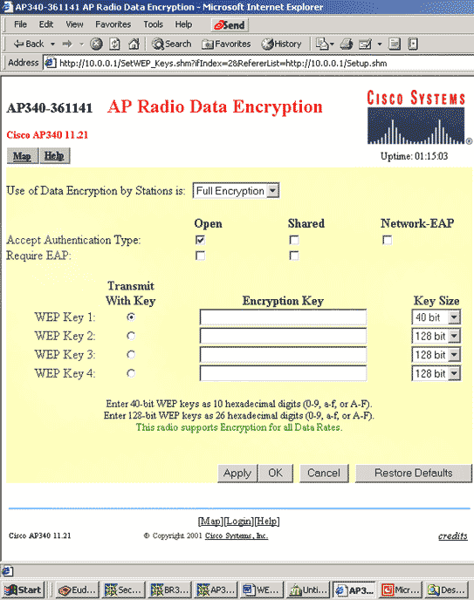
The required length of a WEP key depends on which version of the WEP standard the network runs:
40- or 64-bit WEP: 10 digit key
104- or 128-bit WEP: 26 digit key
256-bit WEP: 58 digit key
To assist administrators in creating correct WEP keys, some brands of wireless network equipment automatically generate WEP keys from regular text (sometimes called a passphrase). Additionally, some public web sites offer automatic WEP key generators that generate random key values that are difficult for outsiders to guess.

Slide 6
Procedure :
Step 1: Configure the Linksys wireless router to require WEP.
Step 2: Configure WEP on the customer wireless workstation.
Step 3: Verify the configuration.

Slide 7
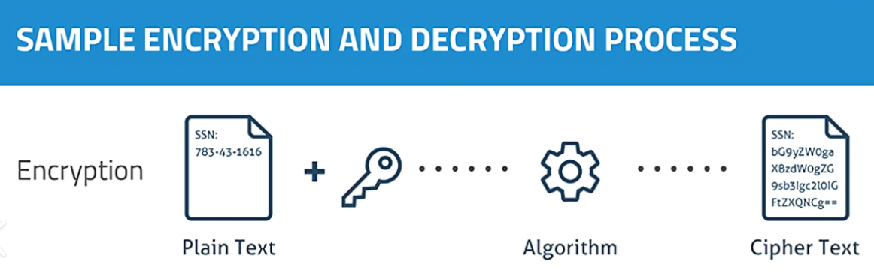
WEP ENCRYPTION
For each packet, a 24-bit initialization vector (IV) is chosen.
The IV concatenated with the root key yields the perpacket key.
The CRC-32 is calculated over the data to be encrypted. The per packet key is then used to encrypt the data followed by the ICV using RC4 stream cipher.
The (unencrypted) IV is transmitted in the header of the packet.

Slide 8
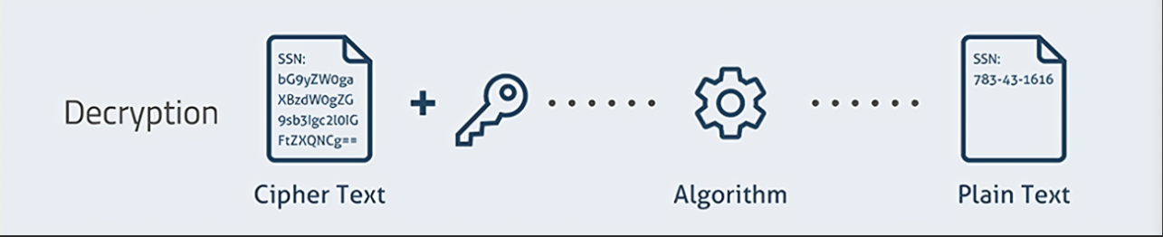
WEP Decryption
The initialization vector (IV) is unencrypted in the header.
The IV is appended to the root key.
The combination of IV and the root key is used as an input for the pseudo-random number generator to generate a bit sequence.
This sequence is XORed with the encrypted data plus ICV to decrypt the data.
The ICV calculation then is run. If the value matches the value of ICV in the incoming frame, the data is considered to be valid.

Slide 9
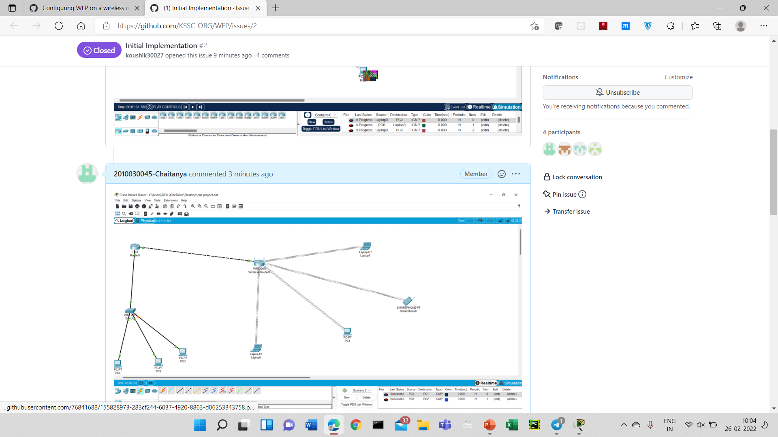
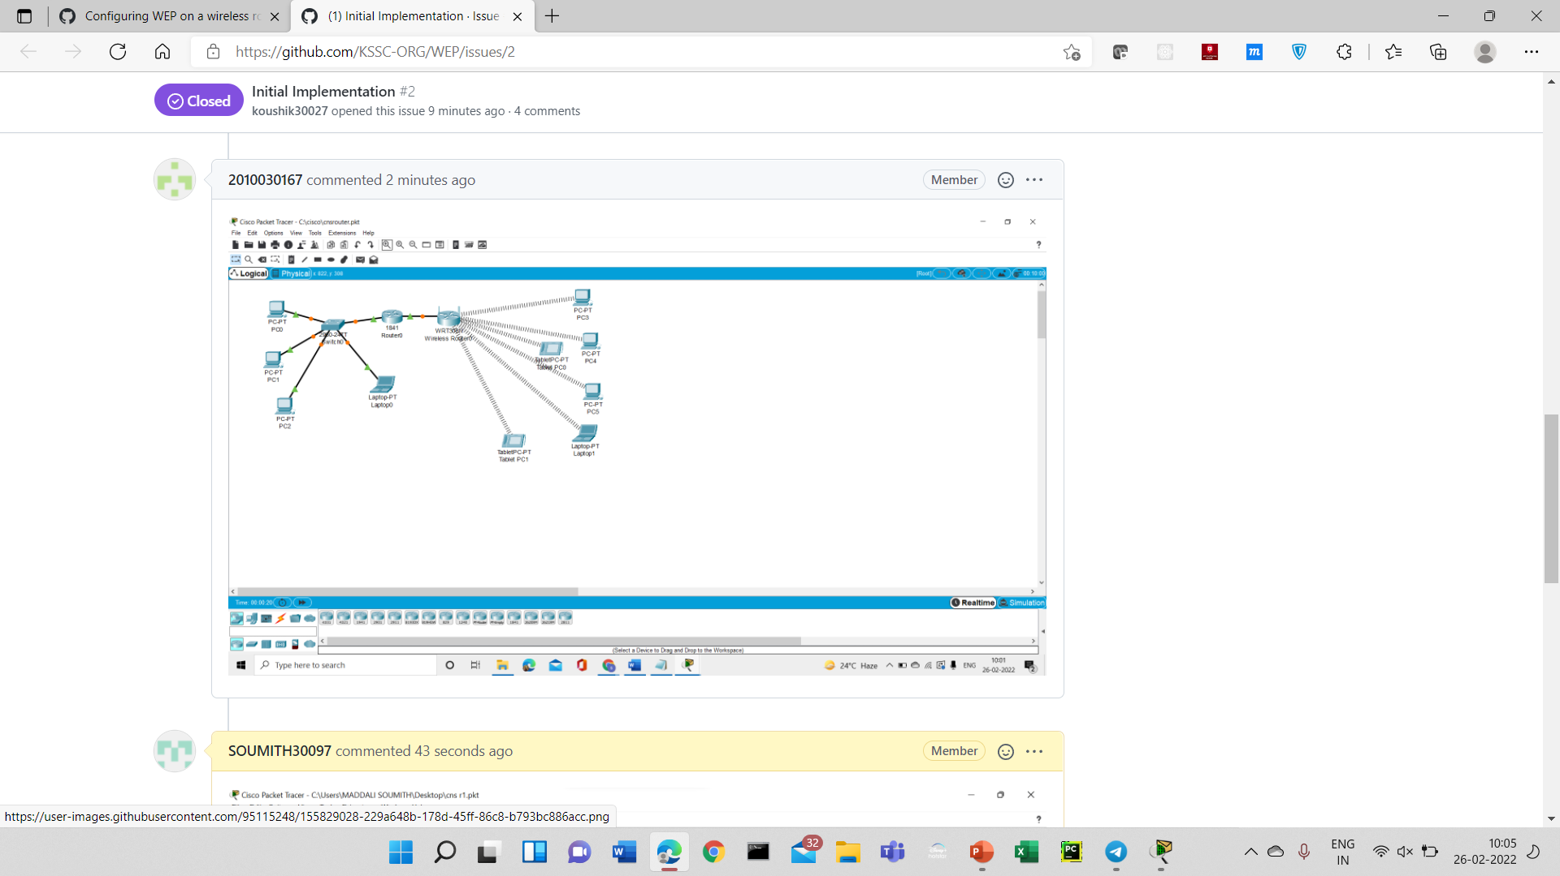
Git hub commits

Slide 10
Work In Progress
In the previous review we have discussed about the project introduction and our approach towards the project. So, in this review Initial implementation our project(Configuring WEP on a Wireless Router) i.e., we have setup WEP Key in the wireless Router and also connected devices .

Slide 11
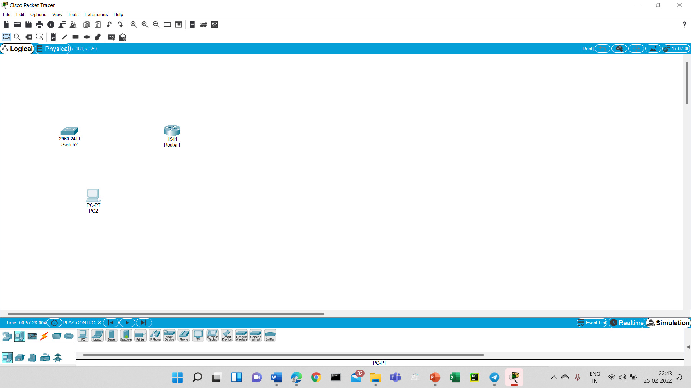
Implementation
Step-1 : First step is we have to take router , switch and pc.
Here we took router because to send the packets through the network.

Slide 12
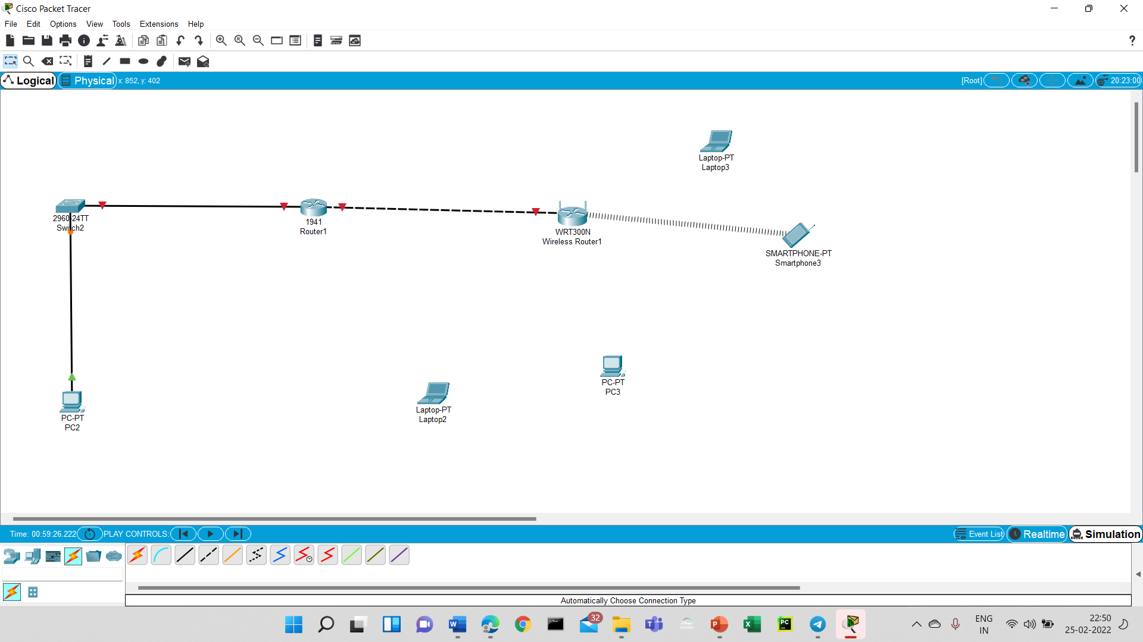
Step -2 :
we have to take wireless router , smartphone and laptop. The smartphone is connected to the wireless router.

Slide 13
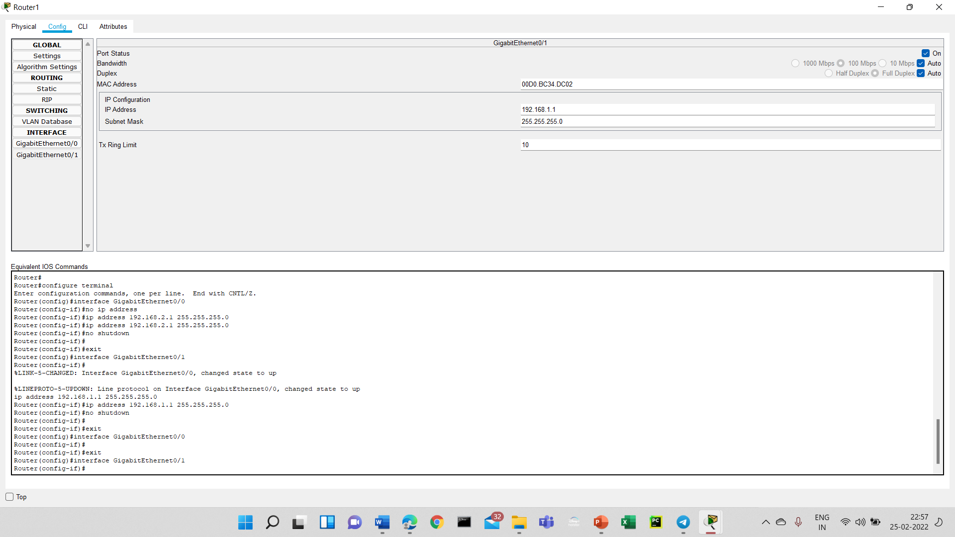
Step-3
Next step is we have to configure the router ip address as ‘192.168.1.2’ in gigabitethernet 0/0 and 0/1 and also we have to turn one to port status

Slide 14
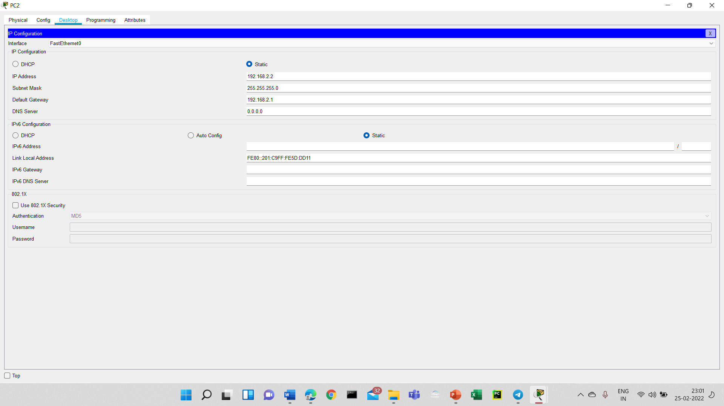
Step :4
We have to click the PCO and add the IP address as the same which we are added in the router and also change default gateway to some IP address.

Slide 15
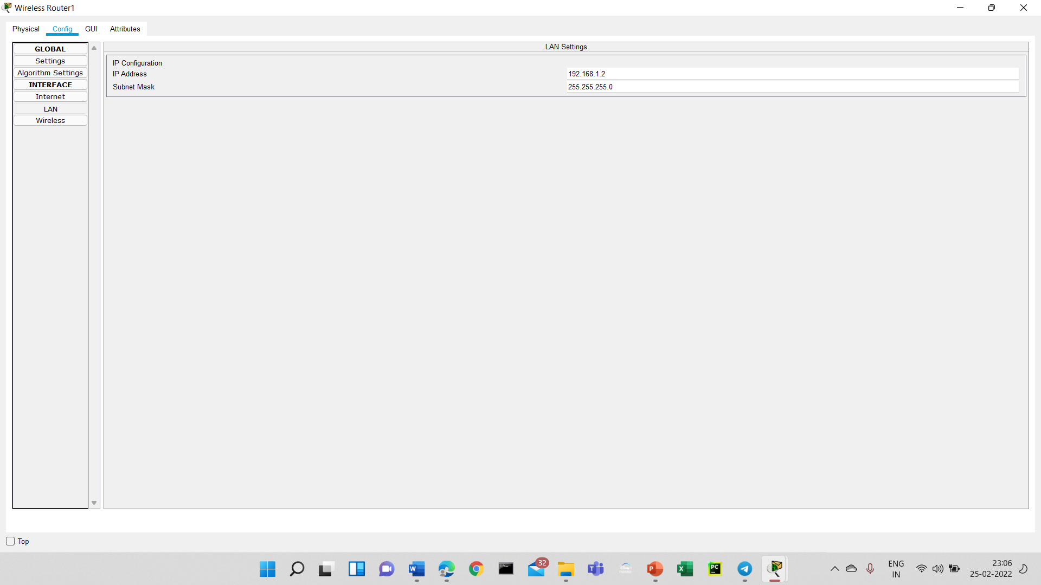
Step-5
We have to check in the cmd prompt which will be available at desktop tab by entering ‘ipconfig’ command to check whether the Ip address and gateways are updated or not.
And also in this we update the lAN IP address and internet gateway in the wireless router.

Slide 16
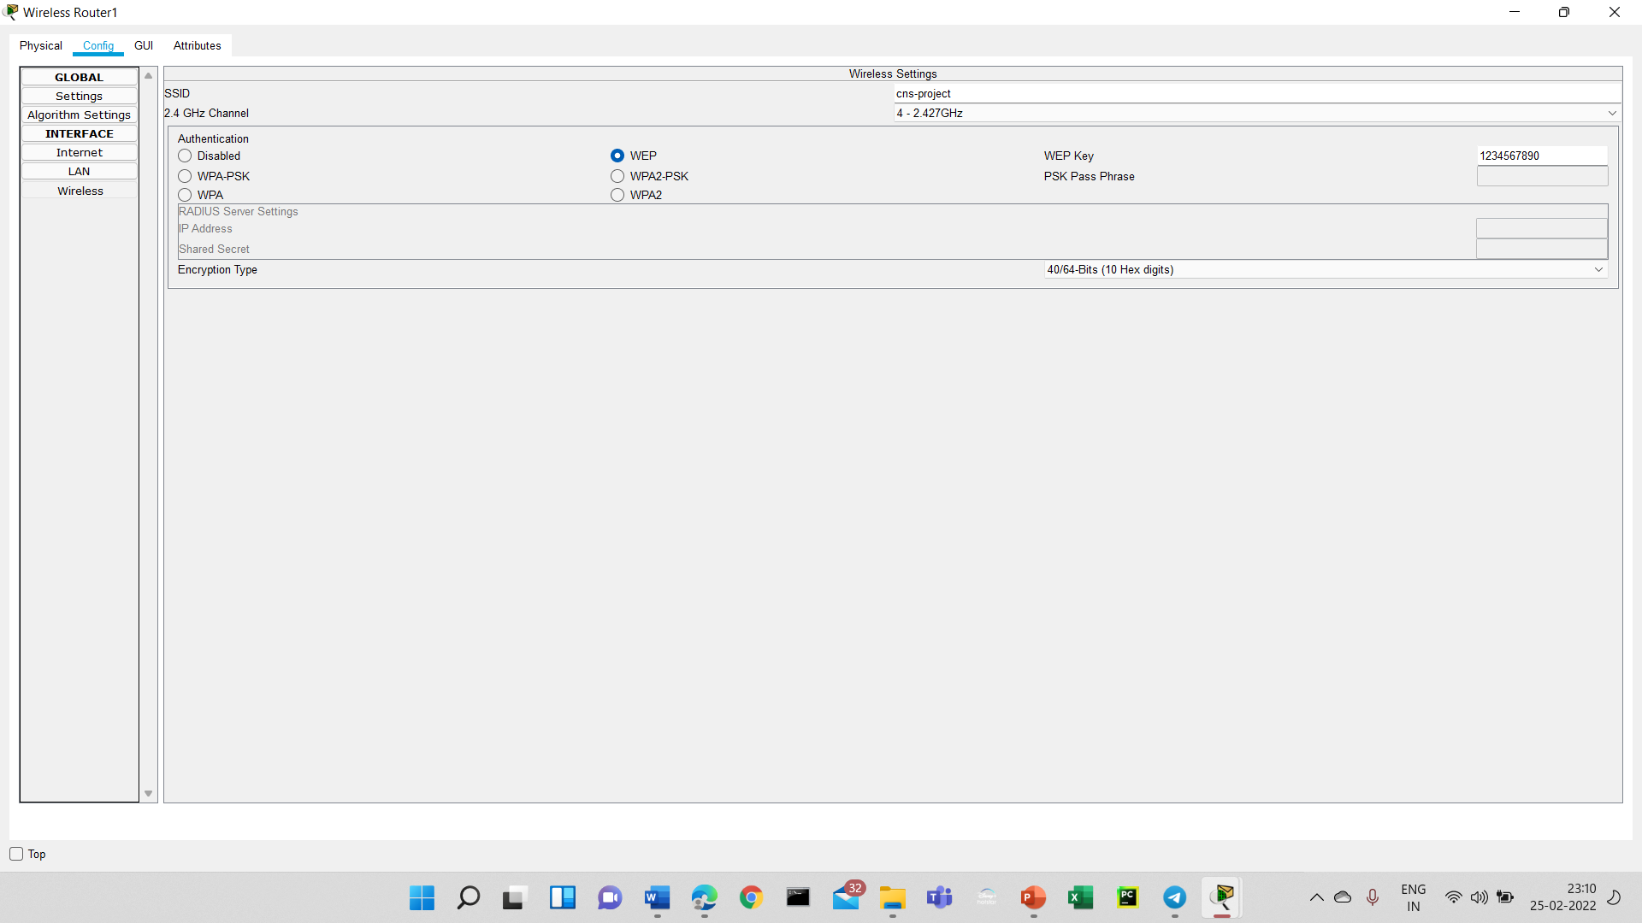
Step-6
We have to change the SSID (Service Set Identifier Information) to our network name. And also we have to set the WEP key which is in the form of hexadecimal to the router.

Slide 17
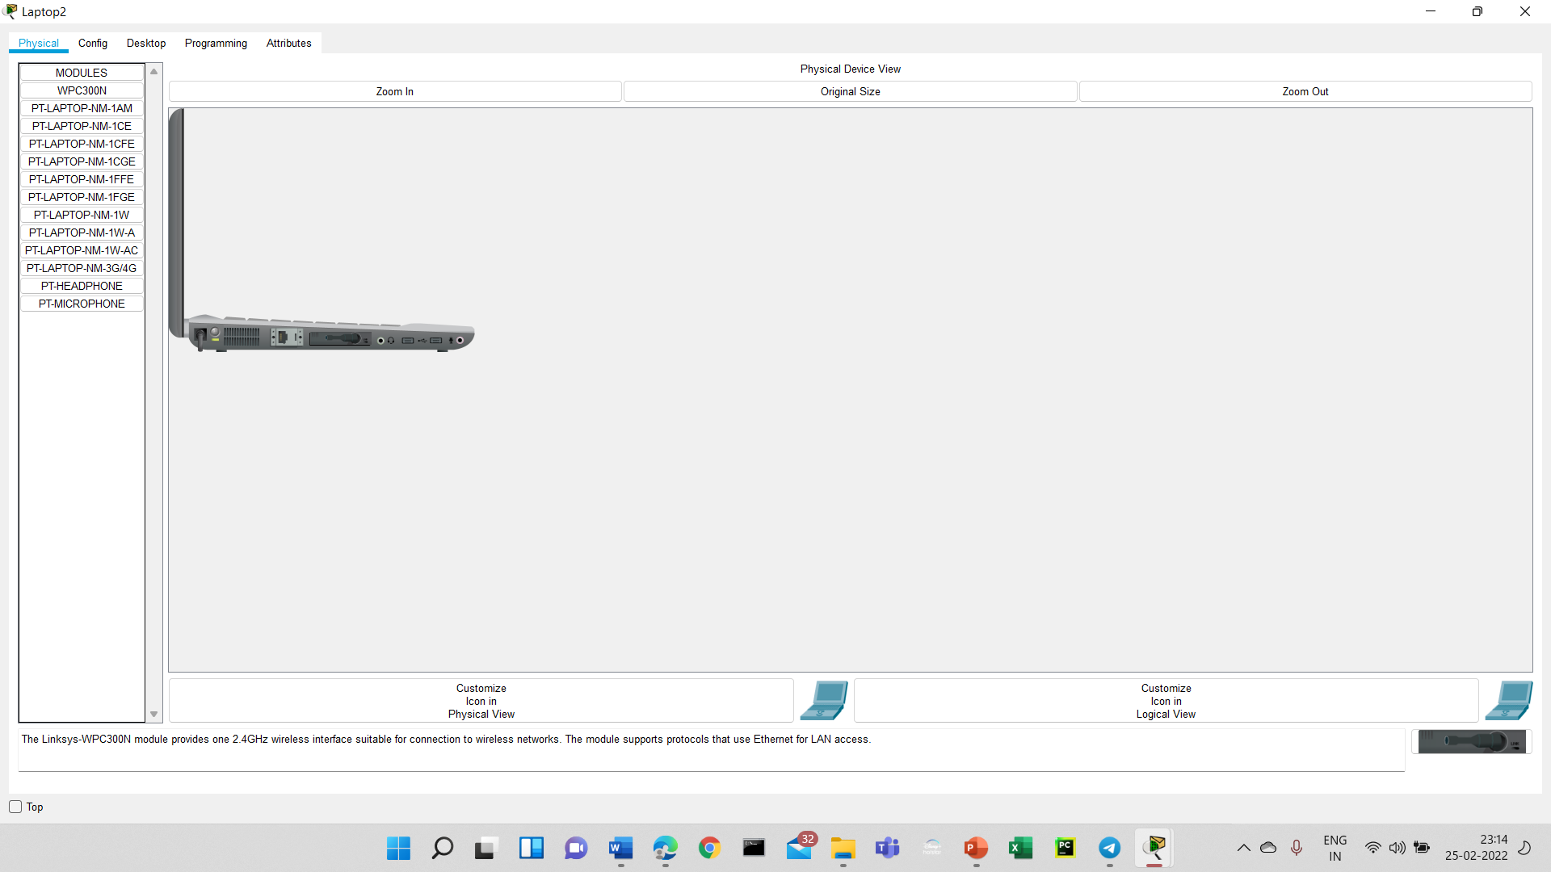
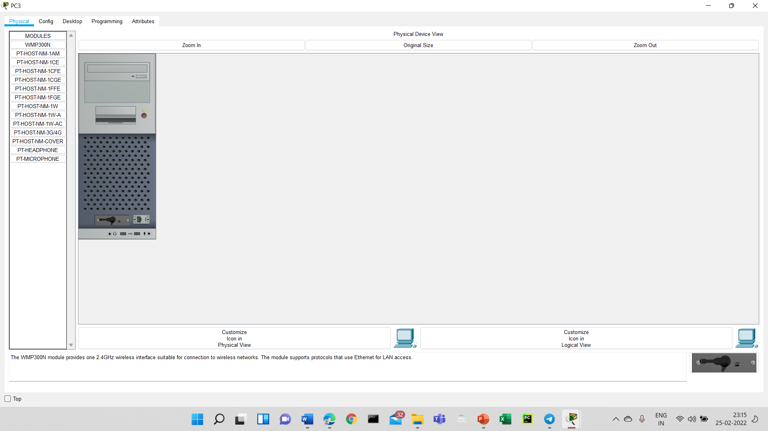
Step-7
Next step is to add the WPC300N (Wireless network adapter) to all the wireless devices. Ex : PC,LAPTOP

Slide 18
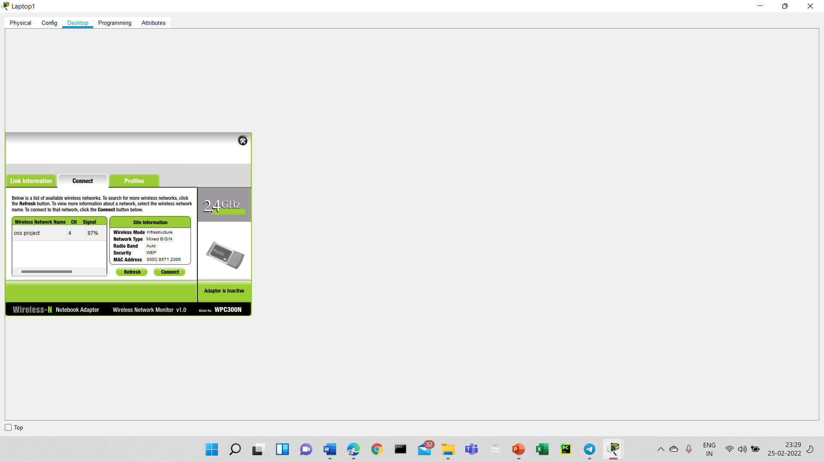
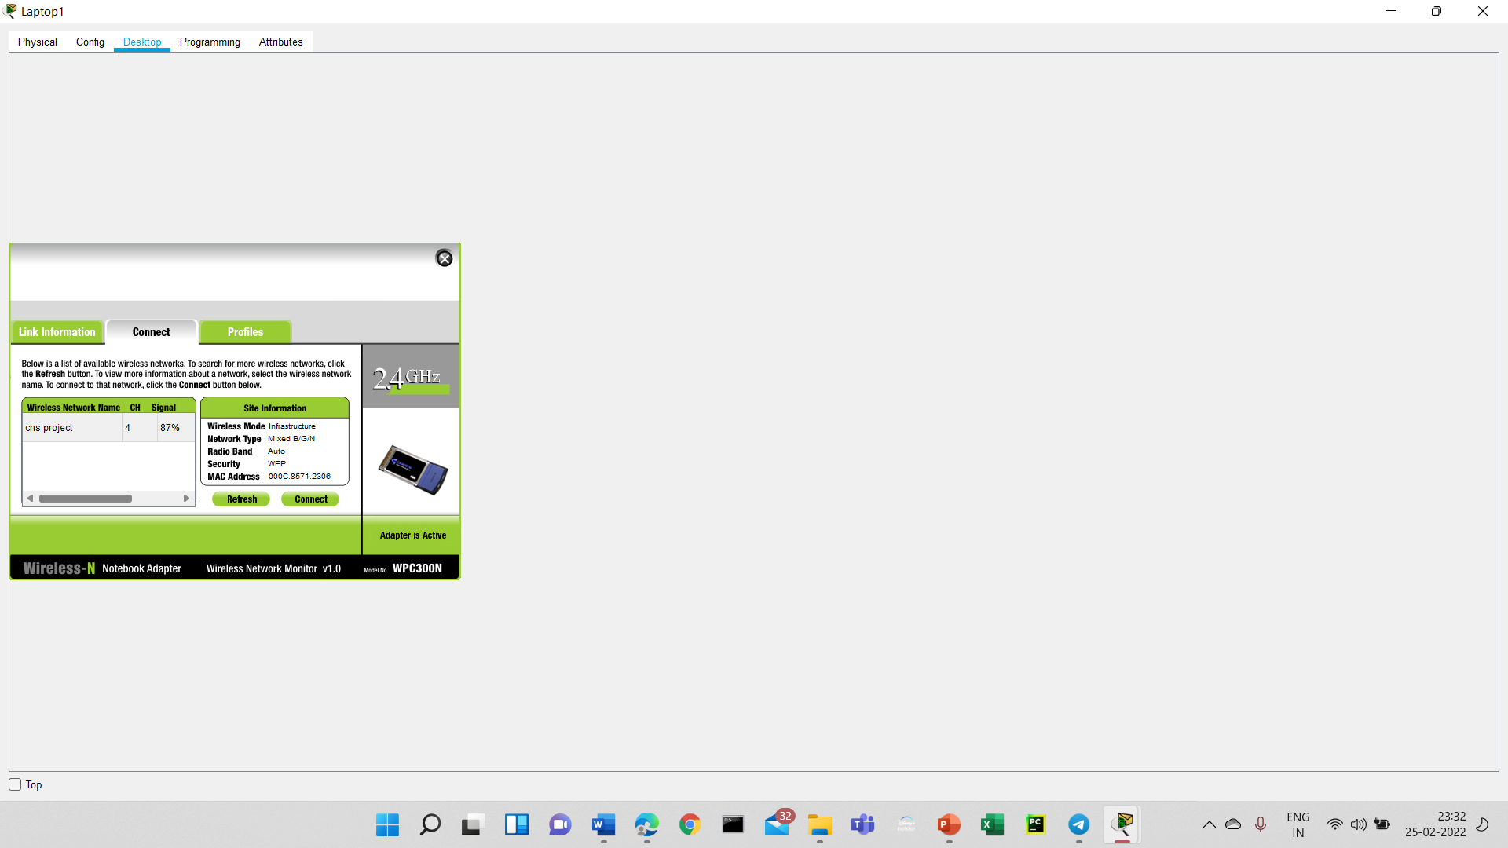
Step-8
We have to connect all PCS AND LAPTOPS to a wireless network name and Entering the wep key which we have set before based on the bit size of our system.For smart phone we have to change the SSID to network name

Slide 19
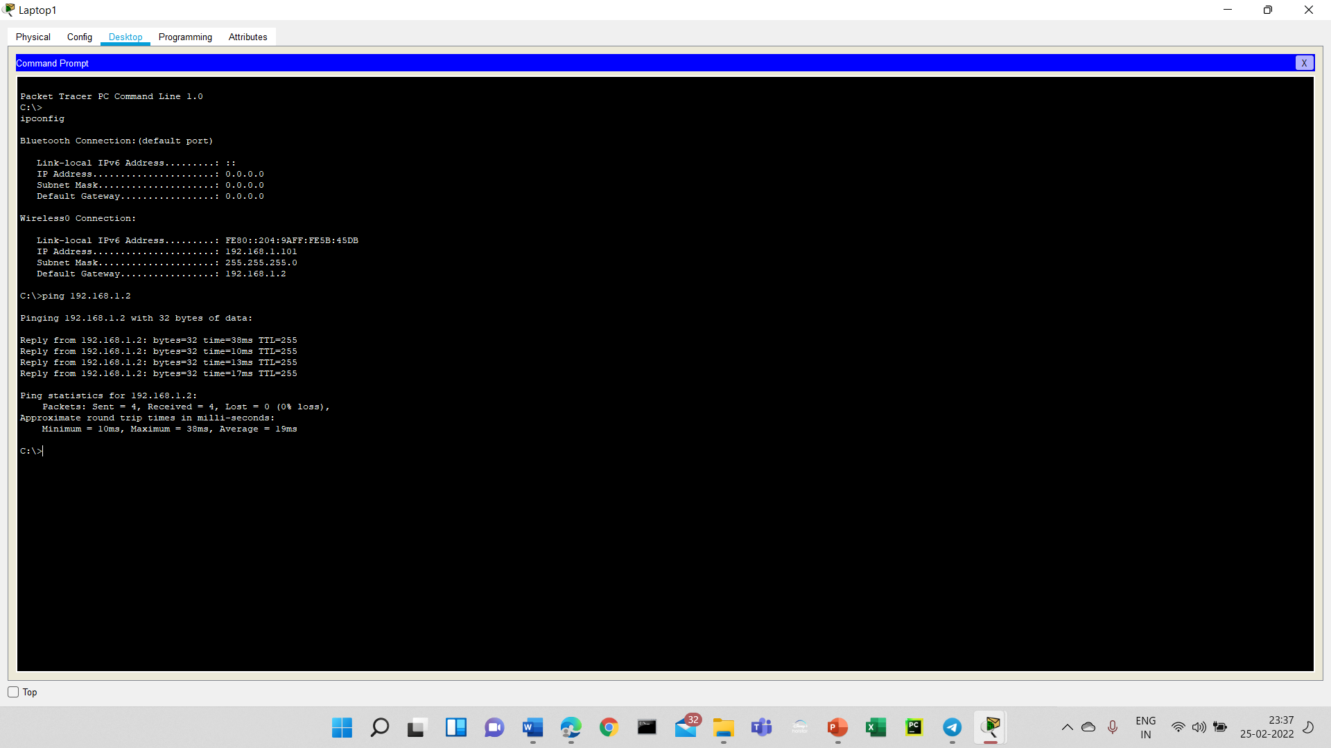
Step-9
Here at last we can check how many packets are sent and how many packets are received by typing ‘ipconfig’ command and ping the IP address

Slide 20
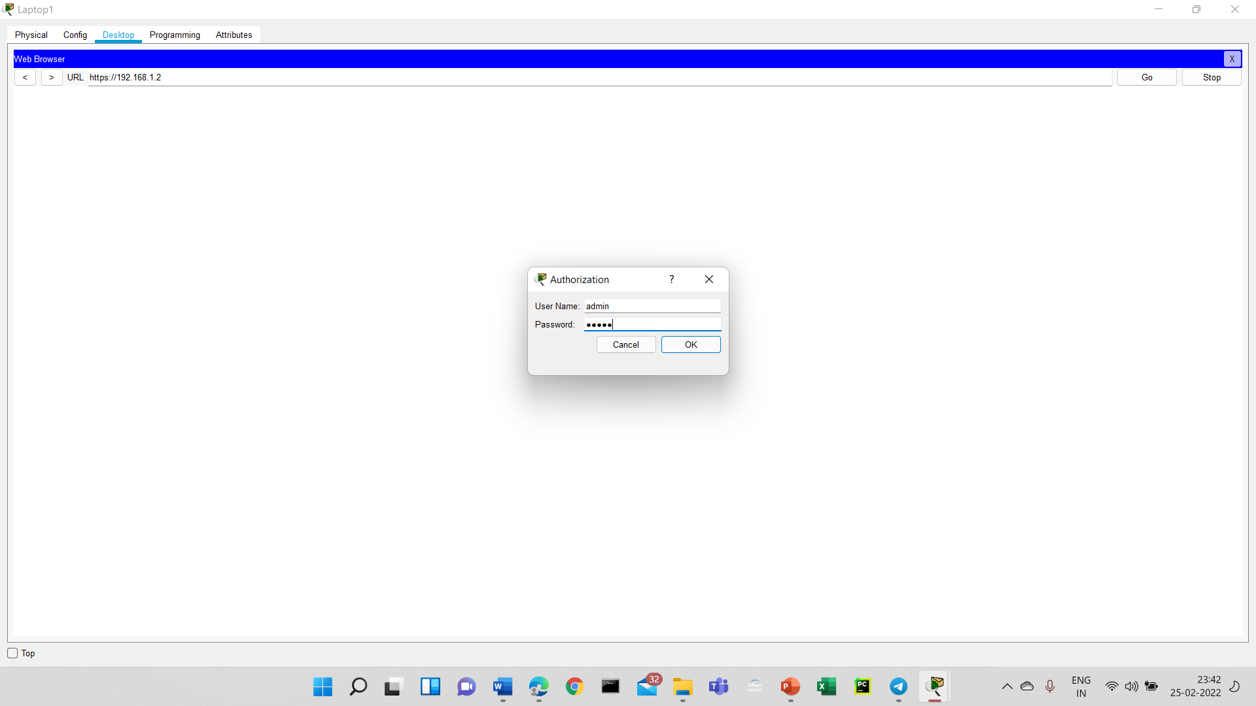
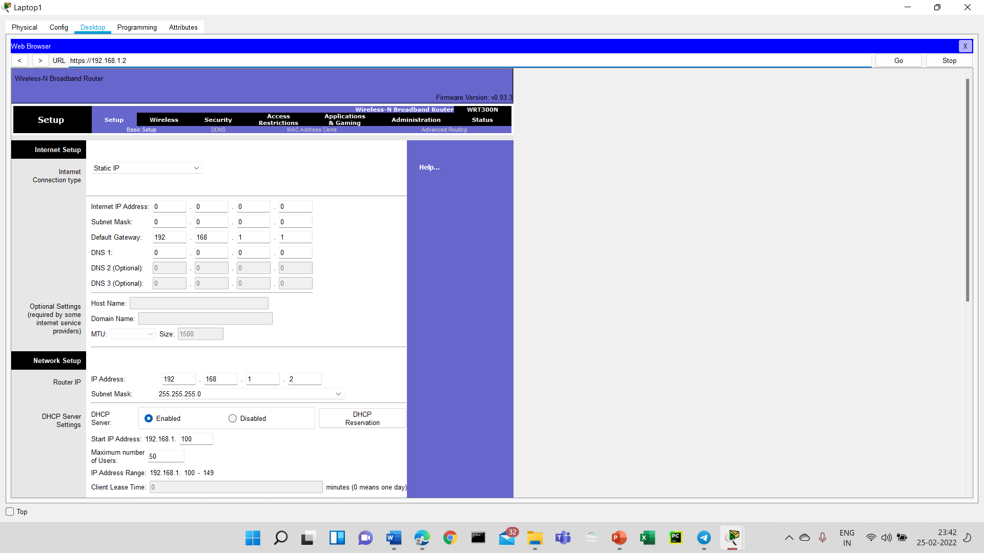
Step-10
Here the last step is to check all the default gateways and Ip addresses which we are changed.For this we have to type our Ip address in our browser and Enter the username and password as admin to see the information.

Slide 21
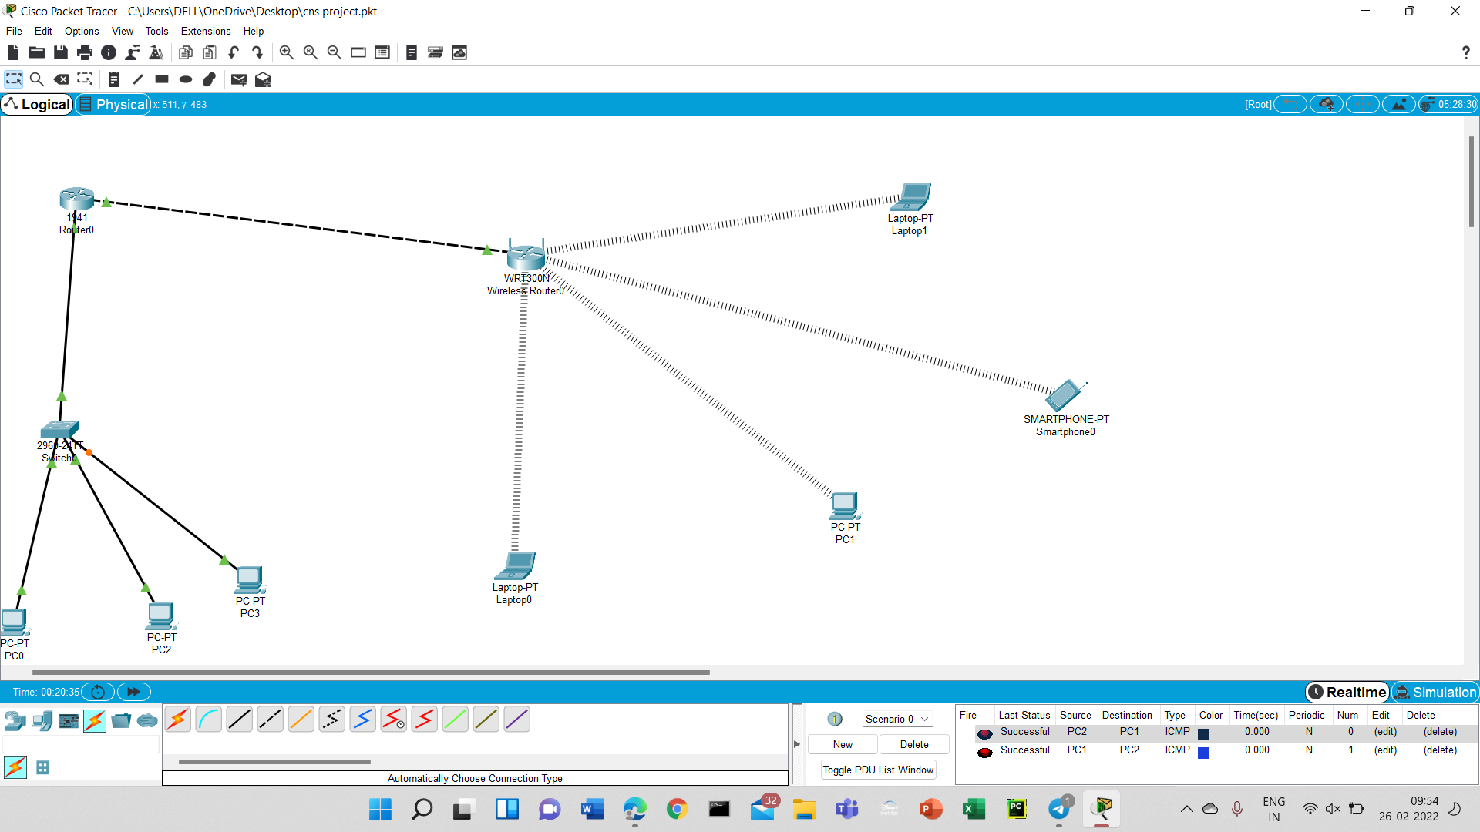

Slide 22
Results
Here our Total project is in between the router and the client server.
At the end of the project we can understood that WEP is essential to secure the severs.
The packets which transfer the information will contain a WEP key and It can be decrypted and will back into the original state.

